Slide 1
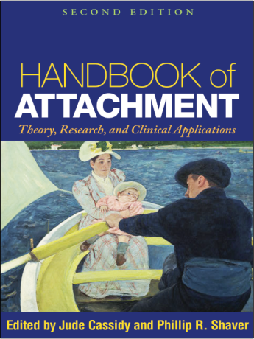
Dissecting Adult Attachment Processes:
An Attachment Perspective on Relational Motives and Dynamics
Part 2
Mario Mikulincer and Phillip R. Shaver
Amsterdam
April 2013
Notes:
1

Slide 2
Overview
Attachment security as a resilience resource
Review of findings from studies showing that attachment security, both dispositional and experimentally induced, facilitates emotion regulation and mental health
Review of key findings showing that being involved in a relationship with a sensitive and supportive romantic partner, group leader, team co-worker, or therapist has long-term beneficial effects on attachment-specific cognitions and feelings as well as broader psychological functioning

Slide 3
Our Model Again
+
Signs of threat?
Activation of other behavioral systems
No
-
Yes
Proximity-seeking strategies
attachment security, distress alleviation
Security-based strategies
+
Is attachment figure available?
-
Yes
No
Insecurity, distress compounding
Is proximity seeking a viable option?
Deactivating strategies
No
Yes
Hyperactivating strategies

Slide 4
If-Then Propositions Implied by the Model
If threatened, seek proximity and protection from an attachment figure (or some stronger, wiser, and supportive force, such as God).
If an attachment figure is available and supportive, relax, enjoy and appreciate the feeling of being loved and comforted, and confidently return to other activities.
If an attachment figure is unavailable, either intensify (hyperactivate) efforts to achieve proximity and comfort or deactivate the attachment system.

Slide 5
Signs of threat?
Activation of other behavioral systems
No
Yes
Proximity-seeking strategies
attachment security, distress alleviation
Security-based strategies
Is attachment figure available?
Yes
Broaden and Build Cycle of Attachment Security

Slide 6
Mental Representations of Attachment Security: The “Secure Base” Script
Repeated experiences of attachment-figure availability and responsiveness result in mental representations of attachment security
These representations are organized around a secure-base script: “If I encounter an obstacle or become distressed, I can approach a significant other for help; he or she is likely to be available and supportive; I will experience relief and comfort as a result of proximity to this person; I can then return to other activities”
Once activated, this script serves as a guide for maintaining emotional stability and adjustment

Slide 7
Attachment Security, Positive Affect, and Mental Health
The sense of attachment security is a fundamental building block of a solid and stable psychological foundation
The sense of being loved and accepted by significant others acts as a resilience resource that facilitates effective coping and adjustment to stress
People with security-supporting mental representations can devote mental resources to growth-oriented activities that facilitate development of a fully functioning personality

Slide 8
Activation of the Sense of Attachment Security and its Effects on Positive Affect, Mental Health, and Interpersonal Relationships

Slide 9
Creation of a Sense of
Attachment Security
The availability and supportiveness of an attachment figure in times of need reduces a person’s distress and engenders positive feelings (being loved, being grateful, being at peace)
In adulthood, these positive feelings can be produced simply by thinking about responsive and supportive attachment figures or retrieving memories of warm and comforting interactions with these people

Slide 10
Priming Attachment Security and Positive Affect
We have used priming techniques to activate mental representations of attachment security; we then measured the emotional effects. Procedures include:
    Subliminal presentation of pictures or words suggesting attachment security
    Subliminal presentation of the names of people who were nominated as security providers
    Guided imagery suggesting the availability and supportiveness of an attachment figure
    Visualization of the faces of security-enhancing attachment figures

Slide 11
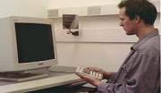
(Sample fixation point,
shows for 500 milliseconds)
X
X

Slide 12
(subliminal, invisible, very quick prime word, for 22 milliseconds)
Love
or
the name of attachment figure

Slide 13
Security priming and positive affect
In several studies, we compared effects of security primes with effects of emotionally positive but non-attachment-related primes (e.g., money, success, humor) or emotionally neutral primes
We consistently found that priming attachment security improves participants’ moods (Mikulincer & Shaver, 2001; Mikulincer, Gillath, et al., 2001, 2003; Mikulincer, Shaver, Gillath, & Nitzberg, 2005)
We also found that security priming infuses formerly neutral symbols (e.g., Chinese ideographs) with positive affect (Mikulincer, Hirschberger, et al., 2001)
This happens even under threatening conditions, and eliminates the detrimental effects that threats otherwise have on liking for previously neutral stimuli

Slide 14
Responses to trauma
We (Mikulincer, Shaver, & Horesh, 2006) wondered whether the soothing effects of security priming might mitigate the emotional damage often caused by traumatic experiences
We conducted a study based on the concept of posttraumatic stress disorder (PTSD), which is, as you know, characterized by repeatedly re-experiencing the traumatic event, emotional numbing, and autonomic, affective hyperarousal

Slide 15
Responses to trauma
We primed representations of attachment security and examined the effects on explicit and implicit responses to the trauma of terrorism in Israel
Explicit responses were assessed with a self-report measure of post-traumatic symptoms
Implicit responses were indicated by mental accessibility of trauma-related concepts (words) in a Stroop task

Slide 16
Method
At the beginning of a semester, 120 Israeli students completed a measure of attachment anxiety and avoidance (ECR, shown earlier today)
A month later, they completed a PTSD Inventory focused on effects of Palestinian terrorist attacks
Based on the total PTSD symptom score, two groups of students were selected to participate in a third session
One group – the PTSD group (N = 30) –
scored above the 75th percentile
The other group – the non-PTSD group (N = 30) – scored below the 25th percentile

Slide 17
Method (continued)
2 to 3 weeks later, the students were invited to a lab, where they performed a Stroop color-naming task including 10 terror-related words, 10 negatively valenced words unrelated to terror, and 10 neutral words
  bomb (say “red”)
  gunfire (say “green”)
They completed each trial while being subliminally primed with an attachment-security word (“being loved”), a positively valenced word not related to attachment (“success”), or a neutral word (“hat”)

Slide 18
Results
Anxious students exhibited more post-traumatic thought intrusions and hyper-arousal symptoms
Avoidant students exhibited more defensive suppression of traumatic thoughts
Students in the PTSD group had longer color-naming latencies for terror words (implying greater mental accessibility or activation of terror-related thoughts)
But this effect was qualified by a significant interaction with experimentally strengthened security

Slide 19
Color-naming latencies (in milliseconds)
for terror-related words
Prime Type

Slide 20
Attachment and PTSD in real life
(Ein-Dor et al., JCounselingP, 2010)
In a sample of Israeli ex-prisoners of war from the 1973 Yom Kippur War, the men’s attachment insecurity predicted their wives’ secondary PTSD symptoms over at least a 6-year period, suggesting that caring for an insecure PTSD victim was costly to their caregiving wives.
Also, the wives’ attachment insecurity predicted their husbands’ symptom severity, suggesting a cycle of traumatization involving both partners.

Slide 21
Attachment security and eating disorders
From an attachment perspective, eating disorders can be viewed as a result of frustrating interactions with attachment figures; associated with insecure attachment and problems in regulating distress and managing close relationships
This hypothesis has received empirical support in correlational studies
We conducted two laboratory experiments assessing the effects of security priming on two frequently observed aspects of eating disorders:
  Preoccupation with food and body shape
  Distorted body image

Slide 22
Attachment security and eating disorders – Study 1
In one study, 45 inpatient women diagnosed with eating disorders and a control group of 45 age-matched healthy women performed a Stroop task while we measured color-naming latencies for words related to food and body shape

Slide 23
Attachment security and eating disorders – Study 2
In Study 2, a second sample of 45 eating disordered inpatient women and 45 age-matched healthy controls performed a computer-based task assessing body-image distortions, using a photograph of them
The photo image was morphed in each direction from the actual picture, by 2% each time, creating 16 steps above and 16 steps below the actual size
Participants were asked to adjust the image of their body until it seemed accurate to them

Slide 24
Attachment security and eating disorders
In both studies, participants were subliminally primed with either a security-promoting stimulus (the name of a security-enhancing attachment figure provided by the participant in a previous session) or the name of a familiar person or the name of an acquaintance who did not fulfill attachment-figure functions

Slide 25
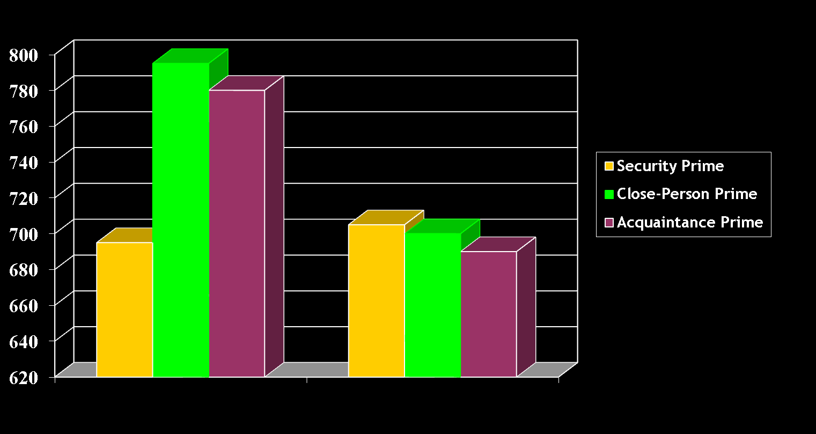
Color naming latencies (in milliseconds) for food and body shape words
Eating Disorder
Group
Control Group
Notes:
No significant interaction effects

Slide 26
Percentage of Distortion from Actual Body Weight
Eating Disorder
Group
Control Group
Notes:
No significant interaction effects

Slide 27
Another effect of enhanced security:
Reduction of out-group derogation
In a series of five studies, we (Mikulincer & Shaver, 2001) found strong evidence for the effects of security priming on out-group intolerance
Higher scores on attachment anxiety were associated with more hostile responses to a variety of out-groups
Experimental heightening of attachment security (e.g., subliminal presentation of security-related words; visualization of the faces of security-enhancing figures) eliminated negative responses to out-groups
Notes:
27

Slide 28
Another example: Attachment and intergroup aggression
Building on these studies, we (Mikulincer & Shaver, 2007) found that increasing the sense of attachment security reduced ‘aggression’ toward a member of an outgroup
Israeli Jewish students completed the ECR scales and participated in a study together with another Israeli Jew or an Israeli Arab (a confederate of the experimenter)
They were then subliminally exposed (for 20 ms) to the name of their own security-enhancing figure, the name of a familiar person, or the name of an acquaintance
Following the priming procedure, participants were informed that they would evaluate a food sample and that they had been randomly selected to give the confederate hot sauce to evaluate
They also learned indirectly that the confederate strongly disliked spicy foods
The dependent variable was the amount of hot sauce allocated to the confederate
Notes:
28

Slide 29
Weight in grams of hot sauce
allocated to the confederate
Arab Confederate
Jewish Confederate
Notes:
No significant interaction effects

Slide 30
Attachment security, authenticity, and dishonesty
(Gillath, Sesko, Shaver, & Chun, JPSP, 2010)
We conducted 8 studies to see if attachment insecurity is associated with being less honest and less authentic.
The first 4 studies showed that authenticity (measured with existing self-report questionnaires) is related to scoring low on attachment anxiety and avoidance and that the two forms of insecurity are associated with different aspects of inauthenticity.
The first set of studies also showed that conscious and unconscious security priming increase state authenticity (compared with neutral or insecurity priming).
The last 4 studies showed that insecurity is related to dishonesty (lying and cheating) and that security priming reduces these tendencies and does so more effectively than positive mood priming.
Notes:
30

Slide 31
Experimentally boosted security and compassionate behavior
We (Mikulincer, Shaver, Gillath, & Nitzberg, 2005) decided to study compassion experimentally. In one experiment (described here), security was increased by unconscious priming with names of supportive attachment figures
In a second experiment, security was increased by conscious priming (asking people to think about specific examples of being comforted by others)
In both studies, people were then asked to help a suffering woman by taking her place in a stressful lab situation
Participants saw a videotaped but purportedly live situation in which a confederate performed aversive, stressful tasks, with increasing reluctance and distress
Participants rated their willingness to replace the confederate
They then said either yes or no to actually replacing her
Notes:
Can these phenomena be studied experimentally, in the laboratory? A preliminary study conducted in Israel and currently being run here.

Slide 32

Post Video Questionnaire
Compassion (7-point scale, 4 items)
“Rate the extent to which you felt…”
Compassionate, Sympathetic, Warm, Tender
Personal Distress (7-point scale, 6 items)
“Rate the extent to which you felt…”
Afraid, Distressed, Uncomfortable,Troubled, Disturbed, Worried
Rated Willingness to Help (7-point scale, single item)
“To what extent did you want to help her?”
Actual Willingness to Help (binary yes/no)
“Would you be willing to help replace her and finish the rest of the tasks for her?”

Slide 33
Study 1: Differences between priming conditions in compassion, personal distress, willingness to help
*
*
The results of Study 2 were virtually identical to these
Compassion
Personal Distress
Rated Willingness to Help
* Significant effect of security prime
Notes:
No significant interaction effects

Slide 34
Study 1: Proportion of participants who were willing to help as a function of priming condition
*
Again, the results of Study 2 were virtually identical to these
Actual Willingness to Help
* Significant effect of security prime

Slide 35
Study 1: Standardized regression coefficients from an analysis predicting four dependent variables from attachment anxiety and avoidance
Dependent Variables | Attachment Anxiety | Attachment Avoidance
Compassion | -.01 | -.31**
Personal Distress | .26** | .02
Willingness to help | -.05 | -.22**
Agreement to help | .06 | -.21**
Notes: * p < .05; ** p < .01. There were no significant interactions between the attachment scales and the priming conditions, and these results were duplicated in Study 2.

Slide 36
Attachment security and hurt feelings
(Shaver, Mikulincer, Lavy, & Cassidy, JSCP, 2009).
70 UC Davis students completed the ECR attachment scales and wrote about a time when a relationship partner hurt their feelings.
They answered four open-ended questions about why the partner’s behavior hurt, the context in which this occurred, the self’s reaction, and the event’s repercussions.

Slide 37
Attachment security and hurt feelings
They were then randomly assigned to conditions and subliminally primed with either security-related words (e.g., love, secure, affection) or neutral words (lamp, staple, building) while rating the similarity of paired pieces of furniture.
They were then asked to think again about the hurtful event and say how they would react if such an event happened now, how rejected they would feel, how constructively they would handle it, and how they would feel about themselves. Also, how they would react (constructively, destructively, crying, etc.).

Slide 38
Results
In the neutral prime condition, attachment anxiety was associated with less constructive reactions and more intense feelings of rejection, more crying, and more negative emotions. But these associations were no longer significant after security priming (a reduction in “hyperactivation”).
In the neutral prime condition, avoidant attachment was associated with less negative appraisals of the hurtful event, less intense feelings of rejection, and less crying, as well as stronger defensive/hostile reactions. After security priming, avoidance was associated with more intense feelings of rejection and less defensive and less hostile responses, and the negative association between avoidant attachment and crying was gone (a reduction in “deactivation”).

Slide 39
Attachment Security and barriers to compassion in couple relationships
In a laboratory experiment conducted in UC Davis, we tested the hypotheses that:
  Both dispositional and contextually augmented attachment security would foster effective provision of secure base for a romantic partner who was disclosing, exploring, and elaborating on his or her personal goals and plans in the near future
  Increased security would overcome potential obstacles to provision of secure base induced by mental depletion.
Notes:
39

Slide 40
Attachment Security and barriers to compassion in couple relationships
Both partners in romantic couples (involved with each other for at least 6 months) were invited to complete questionnaires on a website and then participate in an experimental session.
The sample consisted of 108 couples (mean age of the men = 20.76, mean age of the women = 20.12, mean relationship duration = 22.18 months).
Notes:
40

Slide 41
Attachment Security and barriers to compassion in couple relationships
Dispositional security was assessed with the ECR
Mental depletion was induced by asking the listener to perform a taxing Stroop color-naming task (or, by random assignment, a neutral version of the task)
Contextual bolstering of listener’s attachment security was accomplished by subliminally presenting the names of security providers or neutral names
Couples were then video-recorded during an 10-min interaction in which one of them disclosed his or her personal goals and plans in the near future to the other (“the listener”)
Notes:
41

Slide 42
Attachment Security and barriers to compassion in couple relationships
Two judges provided the following ratings:
  Listeners’ responsiveness (listening, understanding, approving, supporting)
  Listeners’ dismissing/withdrawal behavior
  Listeners’ criticism
Notes:
42

Slide 43
Attachment Security and barriers to compassion in couple relationships
There were significant main effects of priming and cognitive depletion on listener’s responsiveness: Security priming increased responsiveness and cognitive depletion reduced responsiveness.
There was also a significant priming x depletion interaction.
Notes:
43

Slide 44
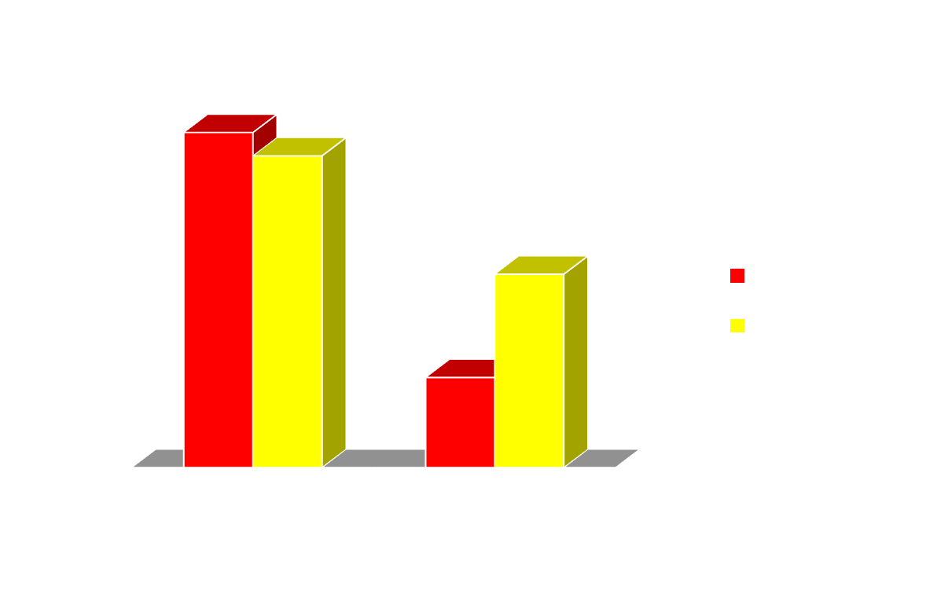
Means of Listener’s Responsiveness Broken Down by Priming and Depletion Conditions
F(1, 104) = 7.81, p < .01
Notes:
44

Slide 45
Attachment Security and barriers to compassion in couple relationships
No significant effects were revealed for listener’s withdrawal or criticism
There were significant main effects of attachment anxiety and avoidance: The higher a listener’s anxious or avoidant attachment, the lower his or her responsiveness to a partner’s goal exploration and the higher his or her criticism towards such an exploration
Notes:
45

Slide 46
Attachment Security and barriers to compassion in couple relationships
Overall, increased security can overcome barriers to responsiveness to a partner’s goal exploration even when a person is tired or depleted. These effects were unexplained by relationship satisfaction.
Notes:
46

Slide 47
Moving from Lab to Life
Experimental studies show that exposure to security-enhancing influences can move an insecure person toward security, with important consequences for mental health and social welfare
In the next section we focus on the extent to which these effects occur naturally, and sometimes deliberately, in romantic relationships, leader-follower relations, groups, and dyadic and community psychotherapy

Slide 48
Augmenting the Sense of Security in Romantic, Leader-Follower, Therapeutic, and Group Relationships

Slide 49
Enhancing Security in Long-Term Romantic Relationships
A romantic/marital relationship often provides the most important context in which to (try to) initiate and sustain a broaden-and-build cycle of security in adulthood
If a romantic partner or spouse occupies the topmost rung in most adults’ attachment hierarchy, this person’s sensitivity and responsiveness to one’s bids for proximity, protection, and security are likely to have important effects on the person’s sense of security

Slide 50
Romantic Relationships as Stress Relievers
Coan, Schaefer, and Davidson (2006) scanned the brains of married women who were undergoing a laboratory stress-induction (threat of electric shock) while either holding their husband’s hand, holding the hand of an unfamiliar male experimenter, or holding no hand at all
Spousal handholding reduced physiological stress responses in the brain (e.g., right anterior insula, superior frontal gyrus, and hypothalamus), and the benefits were greater in more secure relationships
Eisenberger and her colleagues at UCLA found similar effects when a stressed person merely saw a photograph of a partner’s face

Slide 51
Romantic Relationships as Foundations for the Broaden-and-Build Process
Collins and Feeney (2000) found that people whose romantic partner was more sensitive and responsive (as judged by independent coders) when they disclosed a personal problem felt measurably better
In a study of romantic couples discussing one partner’s personal goals, Feeney (2004) found that people were more likely to discuss their goals openly and explore alternative ways to achieve them when their partner was coded by observers as more supportive and responsive, and this made it more likely, over time, that the goals would actually be achieved

Slide 52
Are Security-Enhancing Effects Lasting in Real Life?
Daily diary studies show that people experience stronger feelings of closeness and intimacy on days when their partner is perceived as accepting and responsive to bids for intimacy
However, these studies do not reveal the extent to which such interactions and perceptions lead to long-term changes in attachment organization or move people toward a more secure attachment

Slide 53
Lavi’s (2007) Study
Lavi conducted a prospective longitudinal study of 100 young couples who had been dating for less than 4 months and followed them up 4 and 8 months later
The main question was whether one partner’s availability, sensitivity, and supportiveness, assessed at the beginning of the study, were capable of reducing the other partner’s insecurities within the relationship as well as his or her global attachment insecurities

Slide 54
Lavi’s (2007) Study
Lavi randomly selected one partner in each couple (half men, half women) to be the “participant” and the other to be viewed as the “attachment figure”
The two partners completed self-report scales, performed some computerized tasks, and were videotaped during a series of dyadic interactions

Slide 55
Lavi’s Study Continued
From the “participants,” Lavi collected self-reports of relationship satisfaction, global attachment anxiety and avoidance in close relationships, and attachment insecurities within this particular couple relationship
From the other couple member (the “attachment figure”), she collected information about his/her sensitivity and supportiveness

Slide 56
Lavi’s Study Continued
Measures of sensitivity included (a) self-reports of dispositional empathy, (b) accuracy in decoding emotional facial expressions, and (b) accuracy in decoding emotions that participants displayed in a non-verbal communication task
Measures of supportiveness included (a) self-reports of support provision within the current relationship and (b) supportive behavior, coded by independent judges, during a videotaped dyadic interaction in which participants disclosed a personal problem to the “attachment figure”

Slide 57
Following 4 and 8 months, participants who were still dating the same partner (73%) reported on relationship satisfaction and global and within-relationship attachment insecurities
Within-relationship attachment anxiety and avoidance gradually decreased over the 8 months, implying that maintaining a relationship contributed, on average, to a decrease in relationship-specific attachment insecurities

Slide 58
However, the changes depended on the partner’s sensitivity and supportiveness, assessed by behavioral measures at the beginning of the study
Partners who were more accurate in decoding facial and other nonverbal expressions of negative emotions and who were coded by judges as more supportive caused a steeper decline in within-relationship attachment anxiety and avoidance

Slide 59
Behavioral indicators of a partner’s sensitivity and responsiveness at the beginning of the study predicted a significant decrease in global attachment anxiety over the 8-month period, but not in global avoidance
The findings highlight the importance of a sensitive and responsive romantic partner as a transformative agent who enhances a person’s security in a specific relationship and reduces global worries about rejection and unlovability, but it’s not easy to change global avoidance, even when a person has a responsive partner

Slide 60
Leader-Follower Relationships
Organizational leadership is another example of one person acting as a security provider for others
A leader’s availability, sensitivity, and responsiveness can contribute to followers’ broaden-and-build security cycles, improving their psychological functioning and promoting their personal growth

Slide 61
Leader-Follower Relationships
Like a parent who provides a secure base for exploration, a leader can provide a secure base for initiating and sustaining adaptive changes in personal and social behavior
An unavailable, insensitive, or selfish leader can fuel followers’ attachment insecurities and hence either increase childish, anxious dependence or compulsively self-reliant dismissal of the leader’s ideas and suggestions

Slide 62
Davidovitz, Mikulincer, Shaver,
Ijzak, & Popper (JPSP, 2007)
In two studies, we examined leaders’ attachment insecurities and the ways they contributed adversely to followers’ performance and health

Slide 63
Davidovitz, Mikulincer, Shaver,
Ijzak, & Popper (JPSP, 2007)
In Study 1, 549 Israeli soldiers in regular military service, from 60 different military units participating in a leadership workshop, rated their instrumental and socio-emotional functioning within their unit
Soldiers also rated (a) the extent to which their direct officer empowered them (an other-oriented style of leadership), and (b) the extent to which their direct officer was an effective provider of instrumental and emotional support in demanding situations

Slide 64
The 60 direct officers each completed ratings of his performance as an other-oriented leader and effective provider of support to his followers
They also completed the Experience in Close Relationships (ECR) scale, rating their own attachment anxiety and avoidance

Slide 65
The more avoidant officers scored lower on other-oriented leadership and were less able to deal effectively with their soldiers’ emotional needs
More attachment-anxious officers were less able to provide effective instrumental support
Both insecurely attached officers and their soldiers noticed the same problematic patterns of leadership, suggesting that the problems were objectively observable

Slide 66
There were also negative influences of an officer’s avoidant attachment style on his soldiers’ socio-emotional functioning in their unit
These negative effects were mediated by avoidant officers’ lack of an other-oriented leadership style and lack of efficacy in dealing with soldiers’ emotional needs
An officer’s attachment anxiety had a negative effect on soldiers’ instrumental functioning, an association that was mediated by anxious officers’ lack of ability to provide instrumental support to followers

Slide 67
In a second study, we approached 541 Israeli military recruits and their 72 direct officers at the beginning of a 4-month period of intensive combat training and asked them to report on their attachment styles (using Hazan & Shaver’s, 1987, three prototypes: anxious, avoidant, and secure).
At the same time, soldiers completed a self-report scale measuring their baseline mental heath

Slide 68
After 2 months, soldiers reported on their mental health again and provided appraisals of their officer as a security provider (i.e., the officer’s willingness to be available in times of need and to accept and care for his soldiers rather than rejecting or criticizing them)
Two months later (4 months after combat training began) soldiers once again evaluated their mental health

Slide 69
Findings: The more avoidant an officer was, the less his soldiers viewed him as sensitive and available, and the more they felt rejected and criticized by him
More important, an officer’s avoidant attachment style and his lack of sensitivity and availability brought about undesirable changes in soldiers’ mental health during combat training

Slide 70
At the beginning of training, baseline mental health was exclusively associated with soldiers’ own attachment anxiety
However, officers’ avoidance produced significant changes in soldiers’ mental health over the weeks of training (taking the baseline assessment into account)
The higher the officer’s avoidance score, the more his soldiers’ mental health deteriorated over 2 and 4 months of combat training

Slide 71
Davidovitz et al. (2007) Summarized
These studies reveal the important impact that leaders’ attachment orientations and abilities to serve as security providers can have on followers’ performance, feelings, health, and adjustment
They suggest that leaders’ sensitivity and supportiveness – their ability and willingness to provide a sense of security – can affect the followers’ performance and well-being under societally significant and highly demanding circumstances

Slide 72
Groups as Security Providers
Emotional connections with a group or a network of group members can also be viewed as attachment bonds
A group can serve attachment functions by providing a sense of support and security; and people can use a group as a symbolic source of comfort and safety in times of need and as a secure base for exploration, learning, and personal development

Slide 73
Groups as Security Providers
Comforting and supportive group interactions may have a moderating influence that resembles the positive effects of secure and security-enhancing romantic partners and group leaders
Group cohesion, defined as the extent to which group members support, cooperate with, respect, and accept each other, has consistently been found to improve group members’ emotional well-being and promote learning and effective team performance

Slide 74
Groups as Security Providers
From an attachment perspective, the concept of group cohesion refers to the extent to which a group is appraised by its members as a security provider
Hence, cohesive groups can increase even chronically insecure group members’ secure group attachments, which contributes to their broaden-and-build cycles and provides a solid foundation for taking productive risks and responding to challenges

Slide 75
Rom and Mikulincer’s (2003) Studies
Two naturalistic studies were conducted with new Israeli recruits, whose performance in combat units was evaluated in a 2-day screening session
On the first day, participants completed the ECR as a measure of global attachment anxiety and avoidance in close relationships
On the second day, the recruits were randomly divided into small groups of 5-8 members, and they performed three group missions

Slide 76
Rom and Mikulincer’s (2003) Studies
Following each mission, they rated their socio-emotional and instrumental functioning during the mission and the cohesiveness of their group
External observers also provided ratings of each participant’s socioemotional and instrumental functioning
At the end of the missions, participants rated their anxiety and avoidance with respect to their group

Slide 77
Greater global attachment anxiety was associated with poorer instrumental performance and higher group-specific attachment anxiety
Global avoidant attachment was associated with lower levels of both instrumental and socioemotional functioning and higher group-specific attachment anxiety and avoidance

Slide 78
Group cohesion improved socioemotional and instrumental functioning of group members and reduced the detrimental effects of global attachment anxiety on instrumental functioning during group missions
Group cohesion attenuated group-specific attachment insecurities, whether anxious or avoidant, and weakened the projection of global attachment anxiety onto the group

Slide 79
Although group cohesion had an overall positive effect on performance and on group-specific attachment security, it failed to improve the functioning of avoidant military recruits
Some of the findings even suggested that a cohesive group exacerbated avoidant people’s poor instrumental functioning

Slide 80
Overall, the findings provide evidence that cohesive group interactions, characterized by support, cooperation, respect, and acceptance between group members, can foster a group-specific sense of attachment security, improve group functioning, and have a healing, ameliorative effect on attachment-anxious people

Slide 81
The Therapist as a Secure Base
Psychotherapy is another relational context capable of supporting a broaden-and-build cycle of attachment security
According to Bowlby (1988), a therapist who functions as a safe haven and secure base allows a client to muster the courage for self-exploration, to develop greater self-understanding, revise working models of self and others, and get back on the path to personal growth

Slide 82
The Therapist as a Secure Base
There is research evidence that clients treat their therapist as a safe haven in times of distress
Geller and Farber (1993) found that clients thought about their therapists mainly when painful feelings arose
Rosenzweig, Farber, and Geller (1996) found that such thoughts produced feelings of comfort, safety, and acceptance in the clients

Slide 83
Zuroff and Blatt (2006) assessed patients’ perceptions of the quality of their relationship with their therapist and its impact on the therapy outcome
Perceived quality of the relationship with the therapist predicted relief from depression and maintenance of therapeutic benefits at an 18-month follow-up regardless of the type of therapy administered, and the results were not attributable to patient characteristics or severity of depression

Slide 84
Gur’s (2006) Study
Gur conducted a prospective study examining the course of emotional and behavioral problems of 131 Israeli high-risk adolescents during their first year in residential treatment centers
Four meetings were held with each participant, 1 week after beginning treatment and 3, 6, and 12 months later

Slide 85
Gur’s (2006) Study
At Time 1, participants completed the ECR scale and measures of emotional and behavioral adjustment
In the three subsequent waves of measurement, participants completed the adjustment scales and rated the extent to which targeted staff members functioned as a secure base (the extent to which they were available, sensitive, responsive, and supportive)

Slide 86
In the second, third, and fourth waves of measurement the targeted staff members also rated participants’ adjustment and their own functioning as a secure base
In the fourth wave of measurement, adolescents again completed the ECR so Gur could examine changes in their attachment insecurities

Slide 87
Findings: Staff members serving as a secure base contributed to positive changes in emotional and behavioral adjustment across the four waves of measurement and weakened the detrimental effects of adolescents’ baseline attachment insecurities
Adolescents who formed more secure attachment bonds with staff members had lower rates of anger, depression, and behavioral problems as well as higher rates of positive feelings across the study period

Slide 88
Staff members functioning as a secure base was also associated with positive changes in the adolescents’ attachment representations
Adolescents who formed more secure attachment bonds with staff members had lower scores on the ECR anxiety and avoidance scales after their first year of residential treatment

Slide 89
Overall Conclusions
Our priming studies show that short-term security inductions, whether administered consciously or subliminally, have beneficial effects on mental health
Developmental psychologists have shown that security-enhancing relationships with parents during infancy and childhood have extensive and long-lasting beneficial effects on personality development
Similar processes occur in romantic relationships, leader-follower relations, groups, and psychotherapy

Slide 90
Overall Conclusions
Attachment theory provides a useful starting point for creating a truly integrative understanding of the interactions of personal and social factors that bring about positive changes in individuals and societies

Slide 91

End of Part 2 . . . Questions?
Dank je wel
A full publication list can be acquired by emailing Shaver at prshaver@ucdavis.edu or Mikulincer at mario@idc.ac.il
Notes:
91

